Slide 1
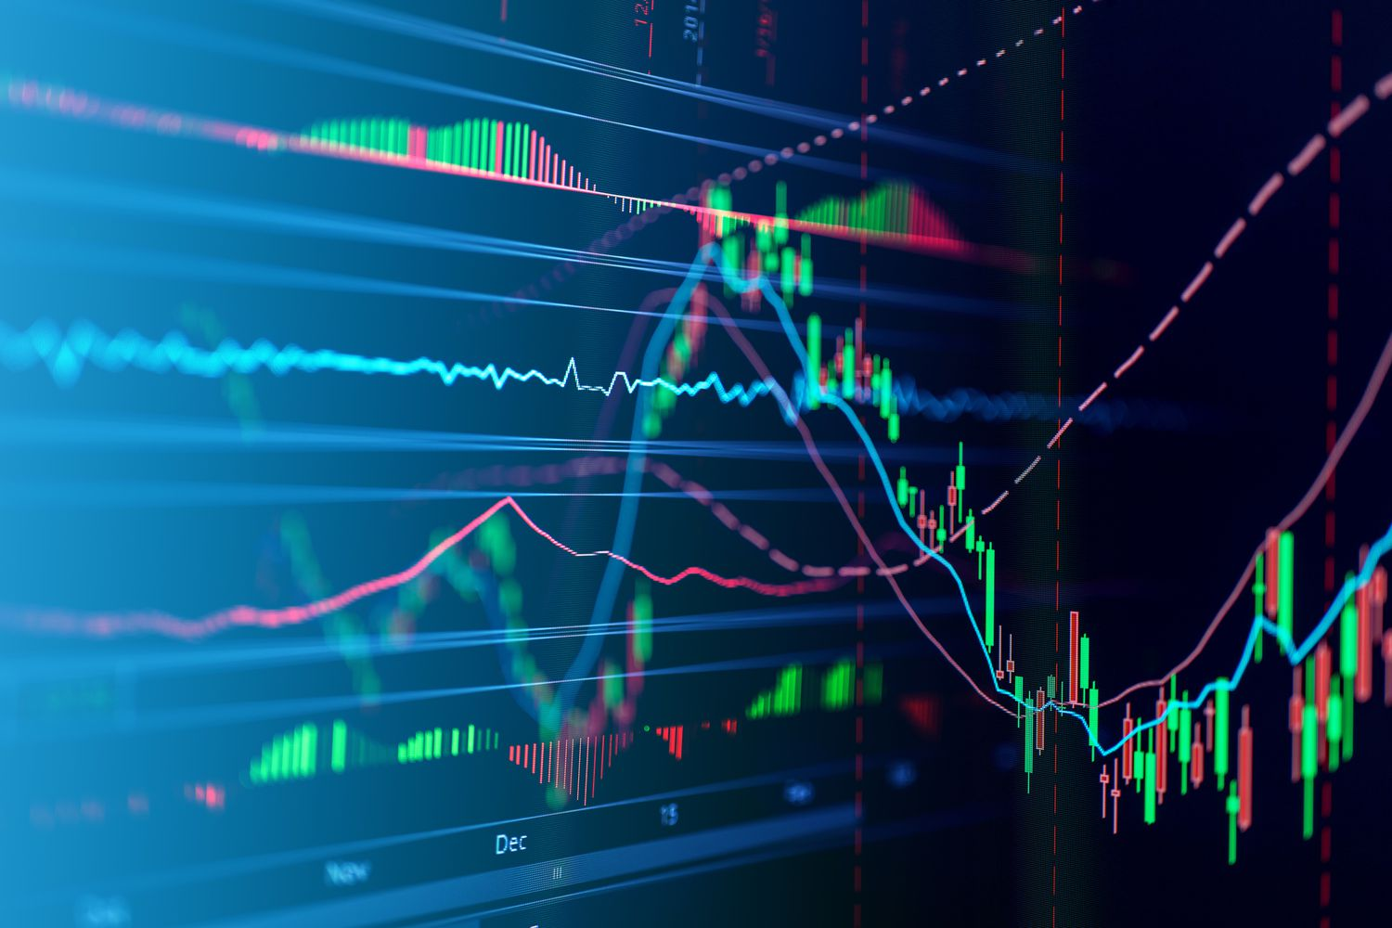
TITRE DE LA PRÉSENTATION
Stock Price and Risk Analysis for
Microsoft, Tesla, and Apple using Excel
OGTIP Data Science Batch 2023
Project 1
Steven Lomon Lennartsson
Alexandre Chauvin

Slide 2
AGENDA
Introduction
Descriptive Statistics: Time series
Descriptive Statistics: Distributions
Regression Modeling and Risk Analysis
Summary

Slide 3
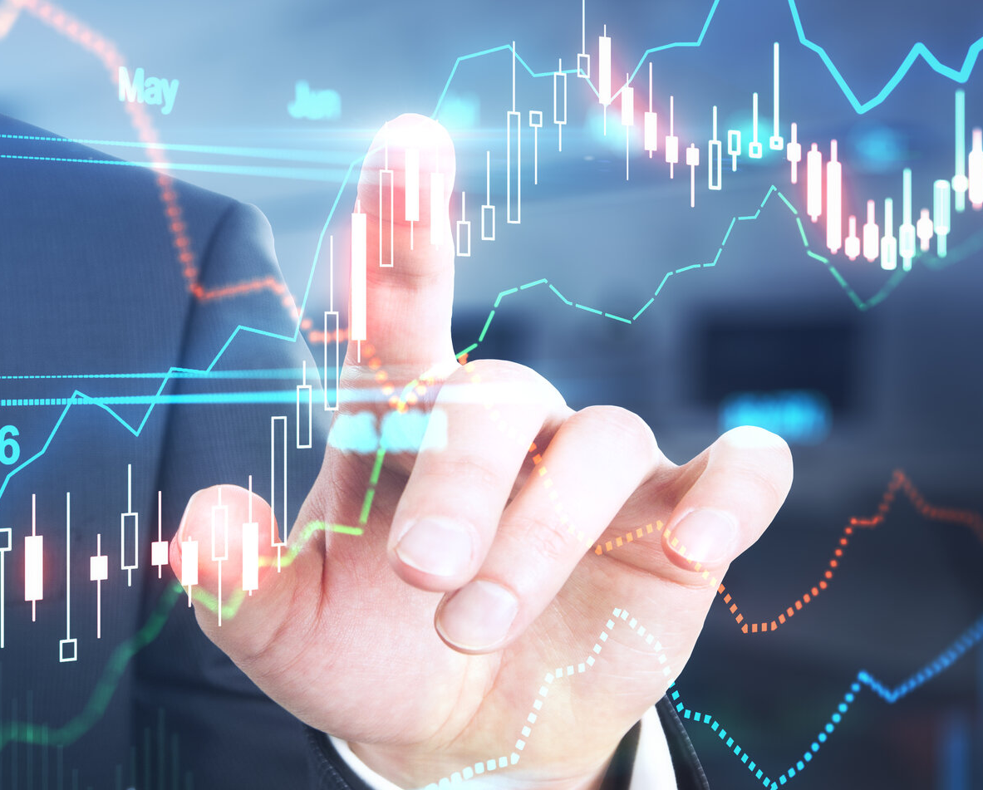
INTRODUCTION
We are given data extracted from Yahoo Finance of 3 major companies: Microsoft, Tesla and Apple. Our dataset is contained by their daily stock value between 2018 and 2023, as well as S&P 500 values during the same time frame. Apart from price data we also have the change (in percentage) between each day.
We will conduct a comparative study of how the different company stocks have performed in the past till today. We will start by analyzing the Excel data and provide descriptive statistics for stock price of the given companies, with complementary charts and diagrams to visualize the data. Furthermore, we will create a regression model over the percentage change of the stock vs market return on the stock for each of the three companies. From the regression models and their metrics, we will make a risk analysis.

Slide 4
DESCRIPTIVE STATISTICS: Time series
All three stocks have an overall positive trend. They all rise steadily until they peak in 2022 in order to then decline, in large parts due to Corona.
Microsoft has a very steady growth with a maximum value of $339.9 and a minimum value of $80.1.
Tesla starts at just ¼ of Microsoft’s value in 2018 but reaches the highest peak out of the three companies with a maximum value of $410.0. Its minimum value is $11.9.
Apple doesn’t reach the same heights but has a stable growth with a maximum value of $180.96 and a minimum value of $34.3.

Slide 5
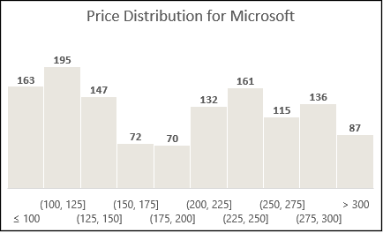
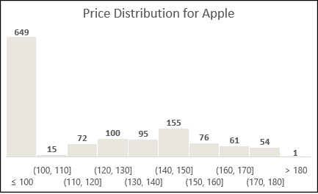
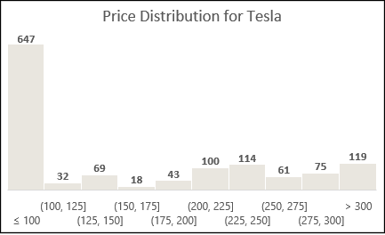
DESCRIPTIVE STATISTICS: Distributions
Here the peaks of Microsoft and Tesla is very clearly shown, Apple only having a single price value above $180.
Microsoft has a mean value of $190.8 and a median of $198.8, indicating a well-centered distrubtion. It has a standard deviation of $75.2 and a skewness of 0.14, hinting at a slight rightward distribution and moderate returns.
Tesla has a mean value of $131.8 and a median of $97.6 which indicates a more disperse price distribution. Combine this with a standard deviation of $117.0 and you have a very volatile stock. It also has a skewness of 0.47, which indicates a significant righward tail, further explaining its peaks and potential high returns.
Apple is the most well-centered distribution with its mean value of $97.4 and median of $94.1. Furthermore it has a modest but stable standard deviation of $46.6 and a skewness of $0.12, just below Microsoft.
All three distributions have a negative kurtosis value from being more tail-heavy compared to a centered normal distribution

Slide 6
Regression ModelING and Risk analysis
The most imprtant metrics in order to gage how well of a regression model we have are the Significant F values and the P-values. They should both be as close to zero as possible and the P-value should also be lower than our alpha value (in this case 0.05). There conditions are true for all these regression models. In the residual plots (not shown here) we can also see that they are all close to the x-axis, also indicating good regression models.
The most important metrics for risk analysis from the regression are the Adjusted R square value and Beta value:
Microsoft has a R square value of 0.60 meaning that 60% of the asset’s performance can be explained by the performance of the S&P 500. It has a Beta value of 1.22. Different enough from the standard (beta of 1) to give good returns without too much risk
Tesla has a R square value of 0.23, showing a weaker relationship between the performance of Tesla and the S&P 500. But the Beta value is 1.83, meaning that we almost have a 1:2 risk reward ratio in a bull market. Very high risk but also high potential reward
Apple has a slightly smaller R square value of 0.55, which is still a significant relationship with the index. Its Beta value is 1.34, meaning that it is slightly riskier than Microsoft in a bull market without reaching Tesla levels of risk-reward.

Slide 7
SUMMARY
With everything we’ve seen, Apple is the safest to bet on. It is both the most well-centered and the most stable. The returns won’t be big but given enough time, one can most likely expect continuous growth and consistent returns. In the absence of a bull market, one shouldn’t have to worry about the risk too much.
For the one who wants a bit more of a challenge with higher returns, Microsoft is a solid pick. Overall suitable for investors with medium risk tolerance.
Tesla is overall not recommended unless you are very experienced or belive you have the mentals to handle the risk involved. It has by far the most disperse distribution, is by far the most volatile, and has by far the highest risk. But with the high risk comes suitably high returns.
Thank you!

